Slide 1
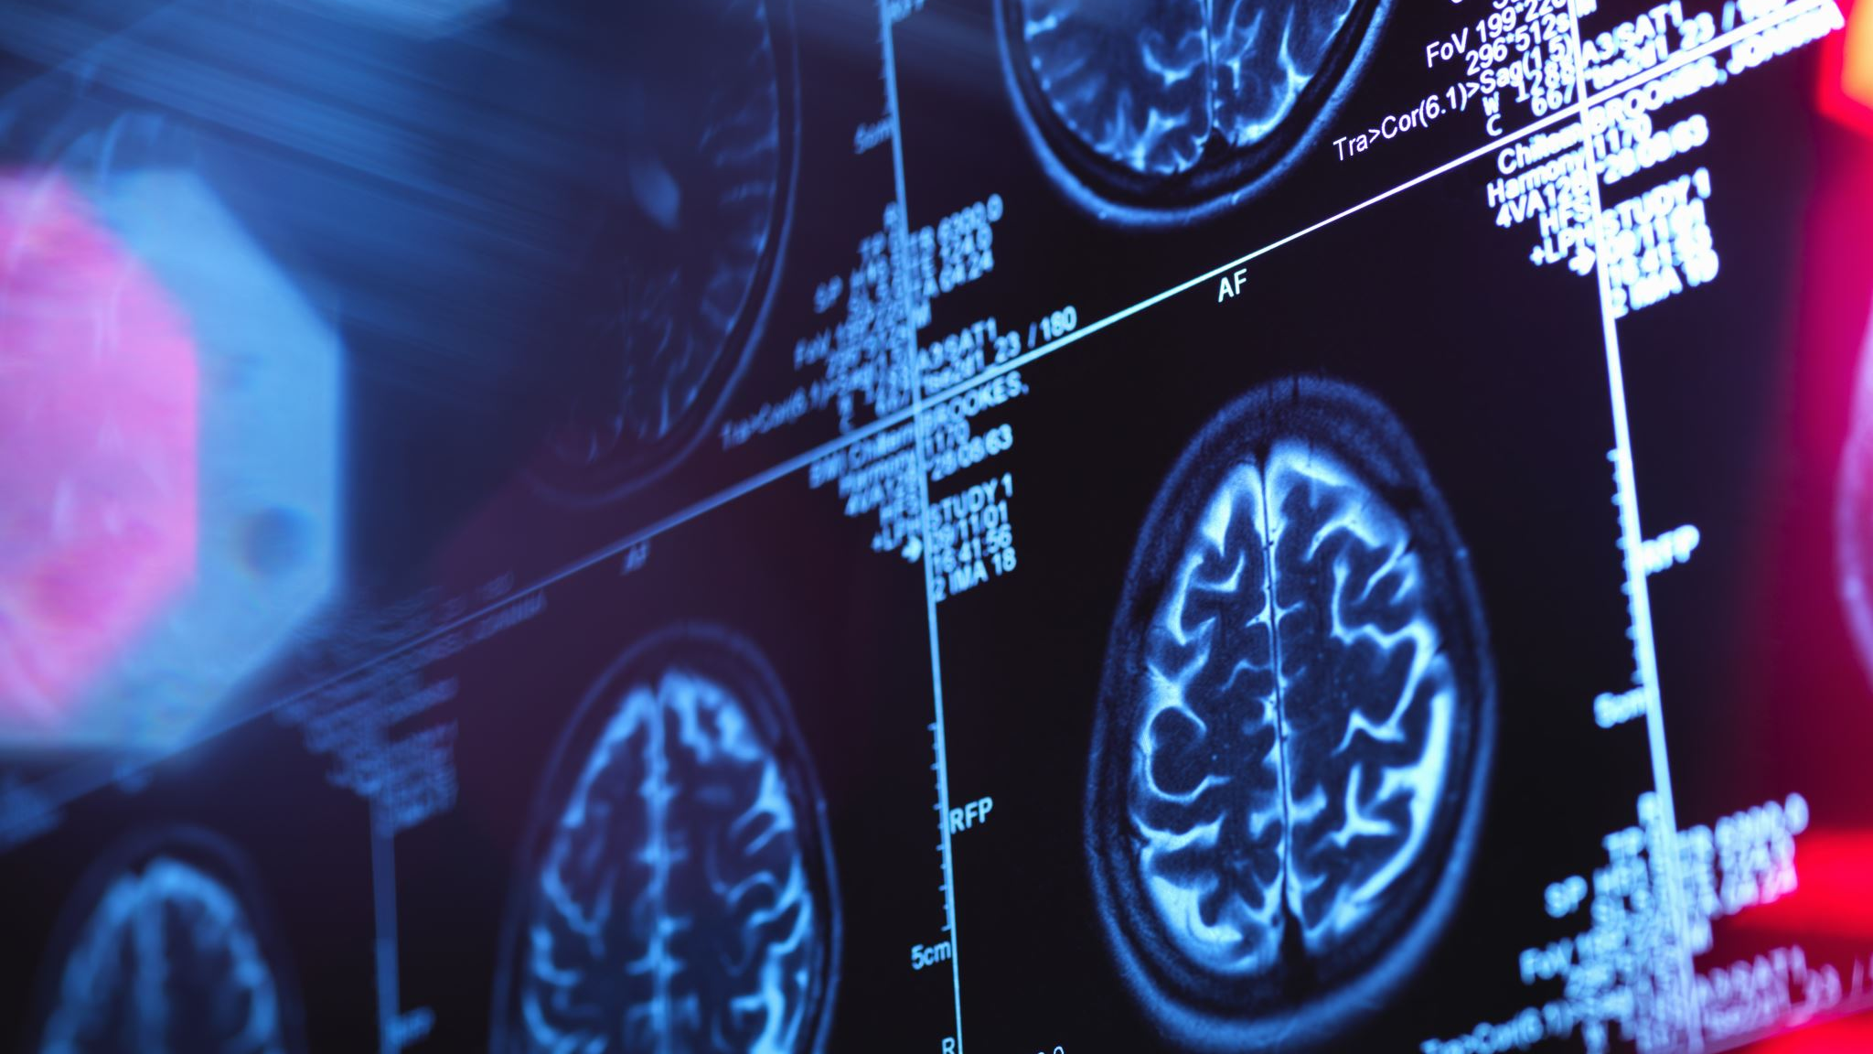
Image Characterization in Radiomics
Team Members : Andrea Smith & Yu Sheng Lu

Slide 2
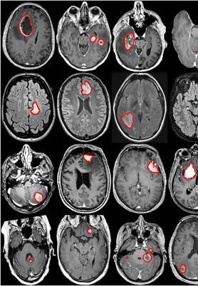
Introduction
Radiomic Features
Extracting information out of medical images
Analyzing Quantitative Imaging Biomarker
Problems We are Trying to Solve
How important is the Radiomic Features for identifying the medical images

Slide 3
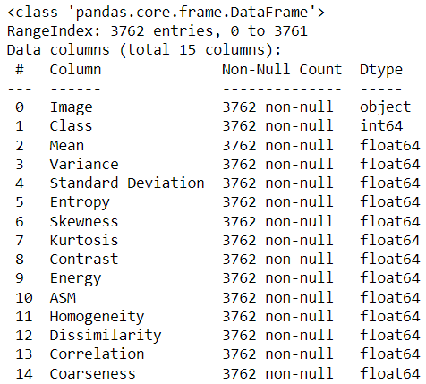
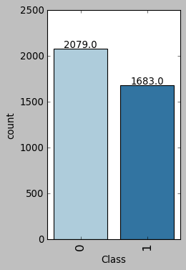
Data Source

Slide 4
Observation of the Data
Higher numbers are correlated with presence of a tumor:
Standard Deviation
Variance
Skewness
Kurtosis
Dissimilarity
Lower numbers are correlated with presence of a tumor:
Entropy
Energy

Slide 5
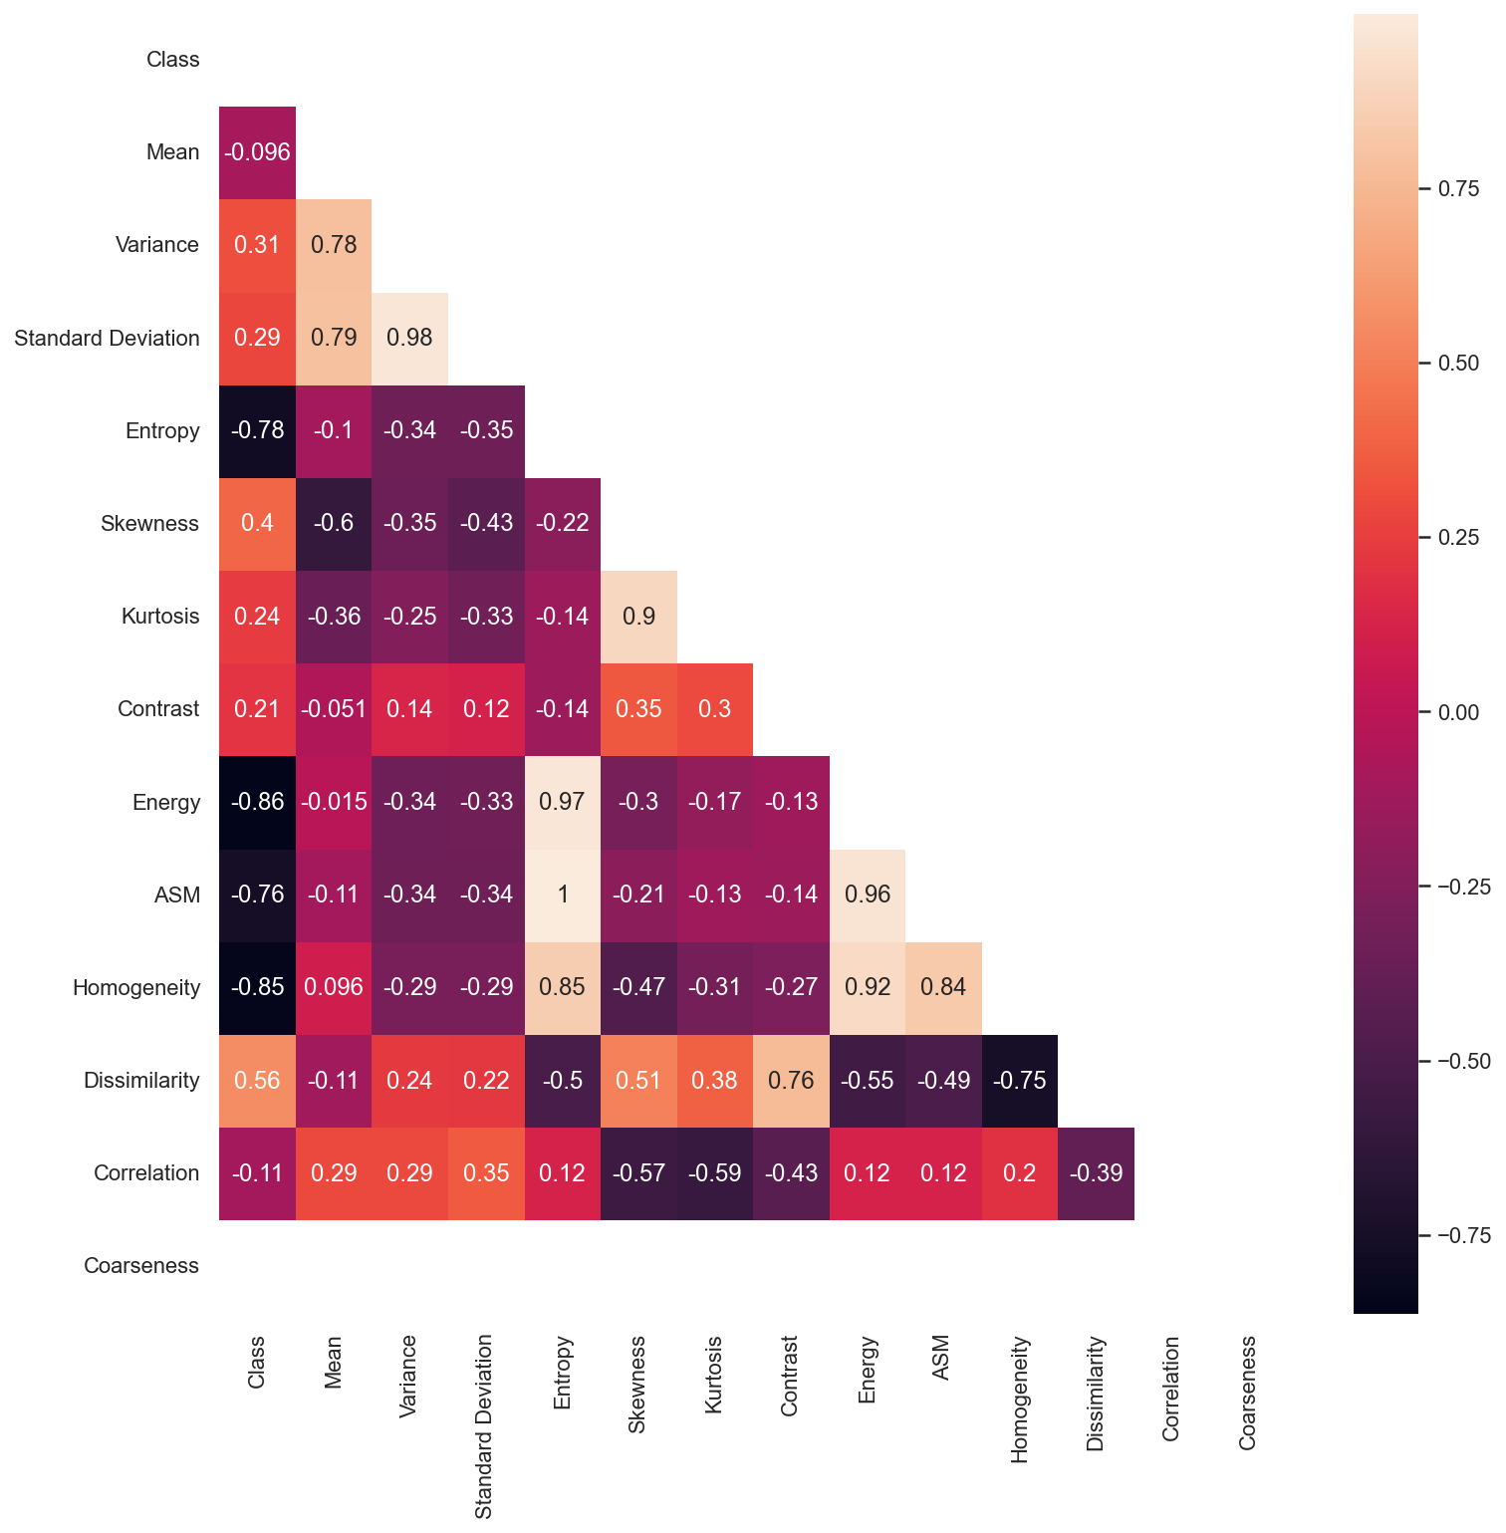
Correlations

Slide 6
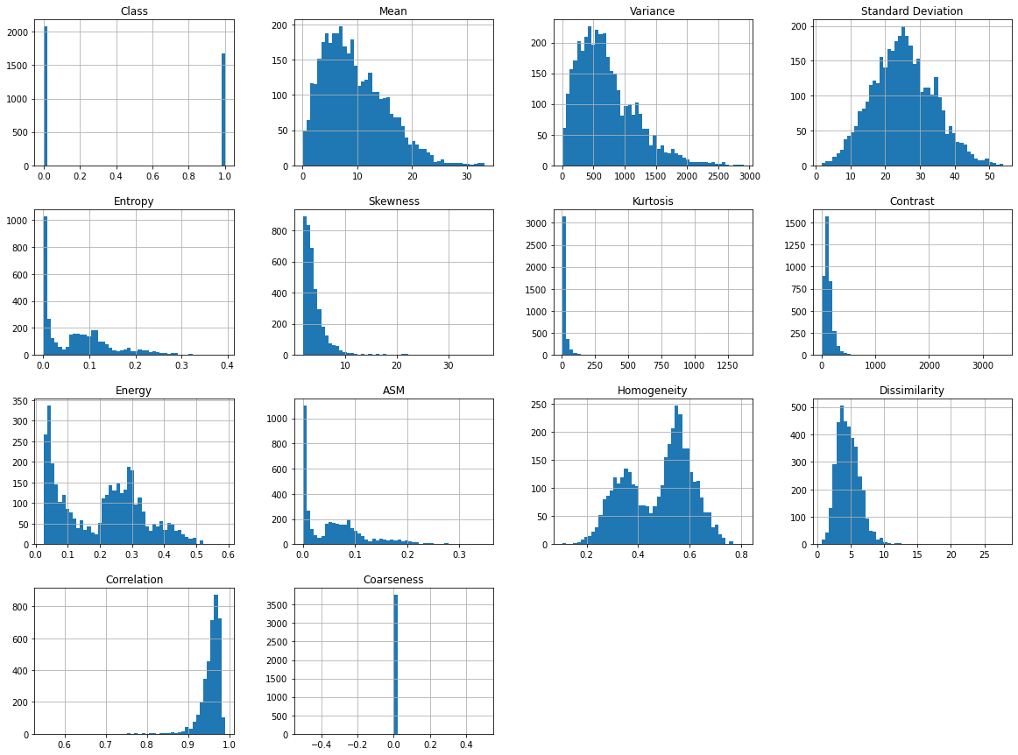
Data Distributions

Slide 7
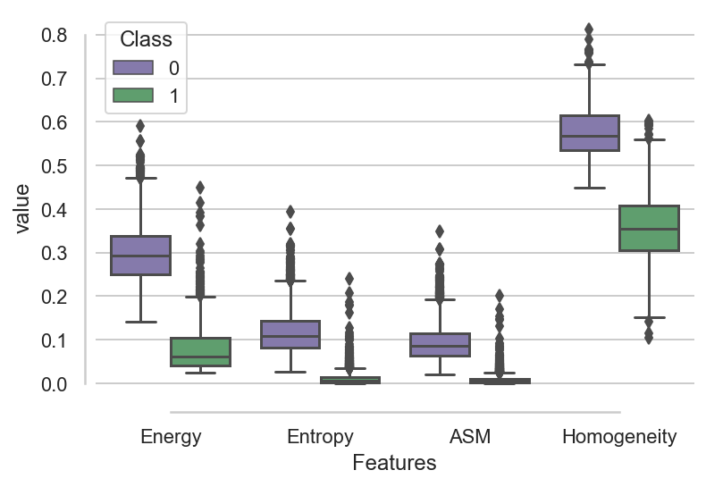
Features that Represent Differences Between Class

Slide 8
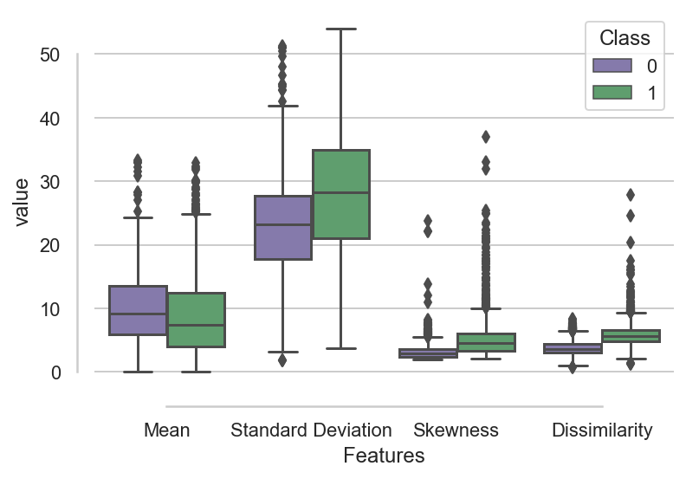
Features that Do not Represent Differences Between Class
Kurtosis, Contrast and Variance also do not show differences

Slide 9
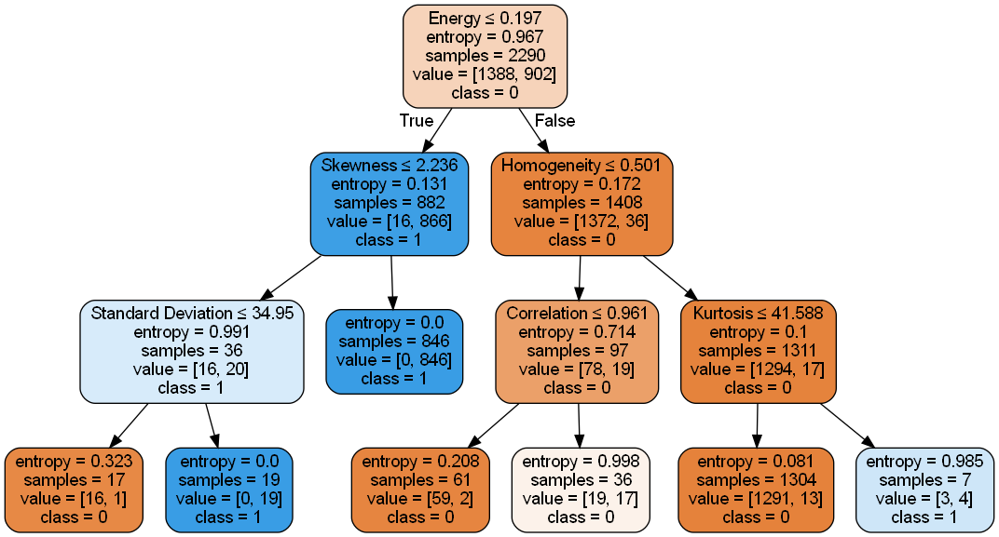
Decision Tree Accuracy: 0.98%

Slide 10
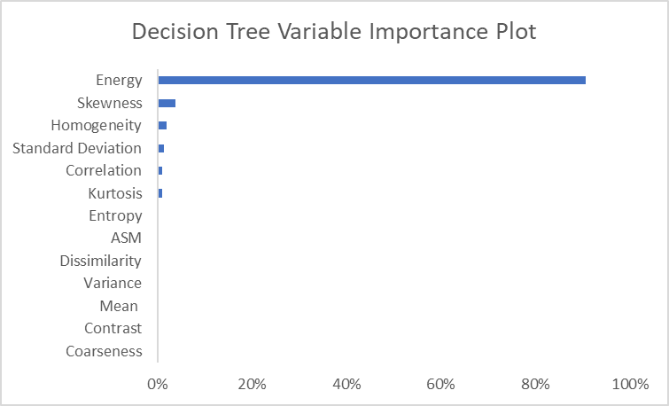
Decision Tree (cont.)

Slide 11
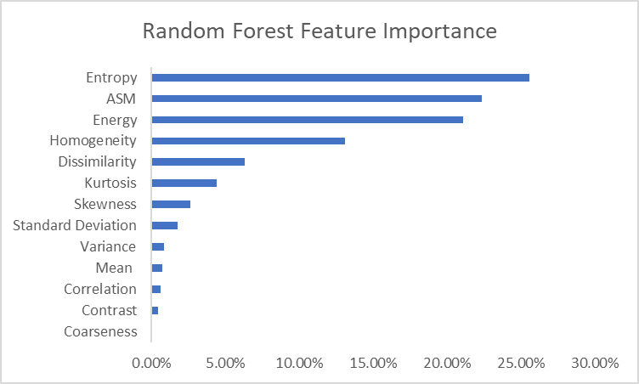
Random Forest Accuracy: 0.98%

Slide 12
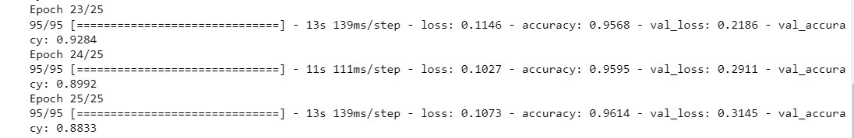
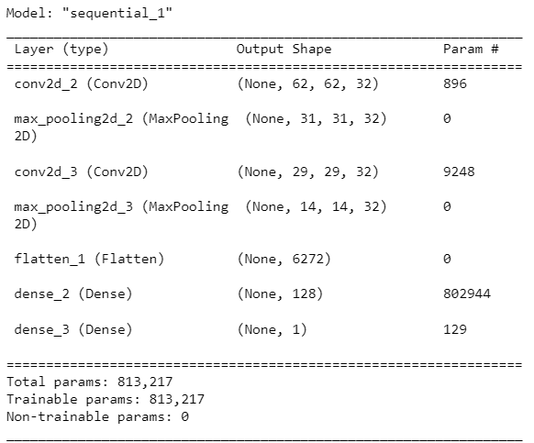
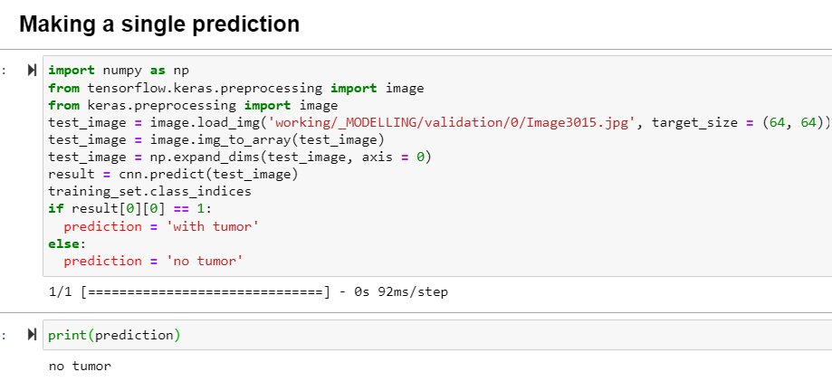
Convolution Neural Network

Slide 13
Conclusion
We saw consistency across of the data across all of our observations of the of the features beginning with EDA and ending with the modeling
Features that were highly correlated and showed differences as represented by the boxplots showed to be high ranking in the feature importance plots of the random forest and decision tree models
These features include: Entropy, ASM, Energy, Homogeneity
It was very interesting to see where the Decision Tree made its decision split
It was also interesting to note that the Random Forest, using a collection of Decision Tree's used more of the variables to make it's decision.
Random Forest did a much better job at using all of the feature variables to to make the decision and classify the data.

